Slide 1









AI FASHION STYLIST
Outfit & Accessory Recommendation System

Slide 2

OUR TEAM
Helly Khambhatwala
(1AUA22BCS018)
Ritu Pal
(1AUA23BCS906)

Slide 3
INTRODUCTION
Fashion is a key part of self-expression, but many struggle to coordinate outfits and accessories. The AI Fashion Stylist uses computer vision and machine learning to recommend tops, bottoms, and accessories based on uploaded clothing images, considering style, occasion, and color harmony to deliver personalized, stylish, and practical suggestions.

Slide 4
FEASIBILITY STUDY
Need: Reduces decision fatigue for consumers
Significance: Useful for e-commerce & styling apps
Technical: Datasets available (Polyvore, DeepFashion2)
Operational: Runs on moderate hardware
Economic: Uses open-source frameworks

Slide 5
OBJECTIVES
Clothing item identification (type, color, fabric, pattern)
Bidirectional recommendations (Top ↔ Bottom + Accessories)
Style & occasion awareness
Color coordination module
Accessory recommendations (shoes, bags, jewelry)
User-friendly web interface
System integration (seamless pipeline)
Evaluation with accuracy & user feedback

Slide 6
LITERATURE SURVEY
The literature highlights datasets like Polyvore, DeepFashion2, and Fashion-Gen, widely used for outfit compatibility and clothing recognition. Research by Han et al. (2017) introduced Bi-LSTMs for fashion compatibility, while recent models like ViT and CLIP improved similarity learning. Industry players such as Amazon, Zalando, and Myntra leverage AI for personalization. However, few systems offer bidirectional recommendations with style and occasion awareness, leaving scope for innovation.

Slide 7
METHODOLOGY
Dataset preparation & preprocessing
Clothing recognition (CNN/ViT)
Feature extraction & embeddings (ResNet, EfficientNet)
Bidirectional recommendation engine
Accessory prediction (multi-label classification)
Color matching (K-means + harmony rules)
Style & occasion classification
Integration → Web application

Slide 8
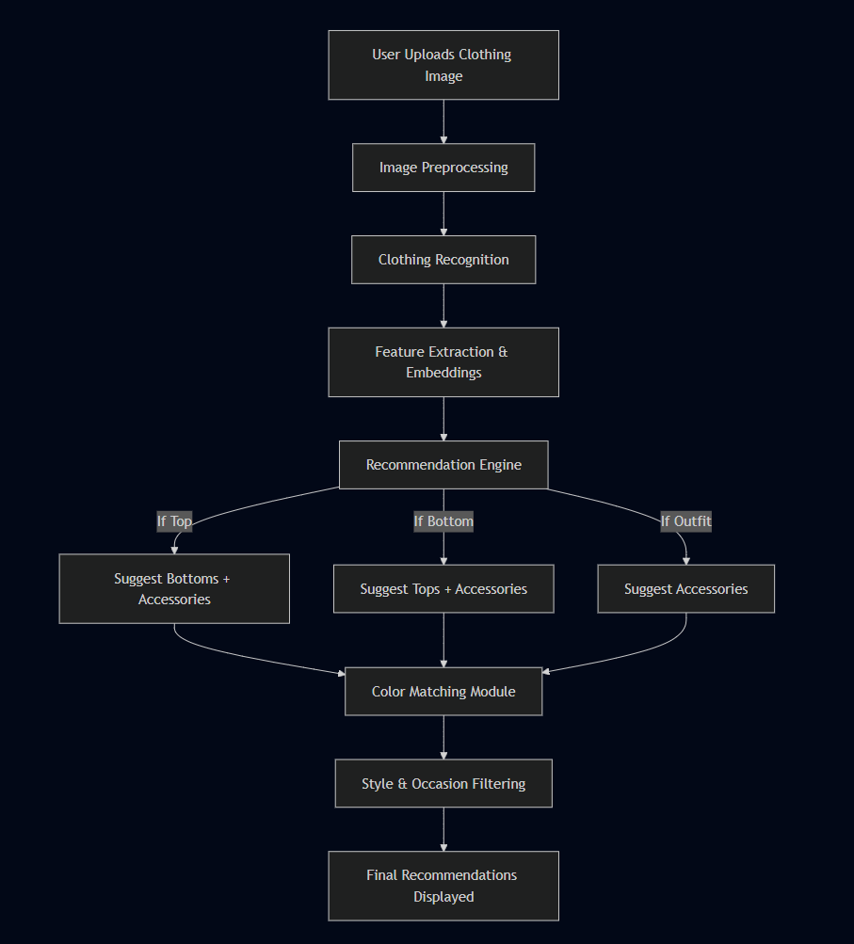
WORKFLOW DIAGRAM

Slide 9
EVALUATION METRICS
Classification Accuracy – clothing type recognition
Top-K Recommendation Success – relevant items in top results
Accessory Precision – correct accessory suggestions
Color Harmony Satisfaction – user feedback
User Evaluation – satisfaction & usability

Slide 10
CONCLUSION
The AI Fashion Stylist reduces decision fatigue by offering smart, context-aware outfit and accessory recommendations. It enhances personalization for users, benefits e-commerce platforms, and holds future potential with AR/VR try-ons and real-time styling assistance.

Slide 11
THANK
YOU

